Slide 1

Optimising Quality-of-Control for Data-intensive Multiprocessor Image-Based Control Systems considering Workload Variations
Sajid Mohamed, Diqing Zhu, Dip Goswami, Twan Basten

Slide 2
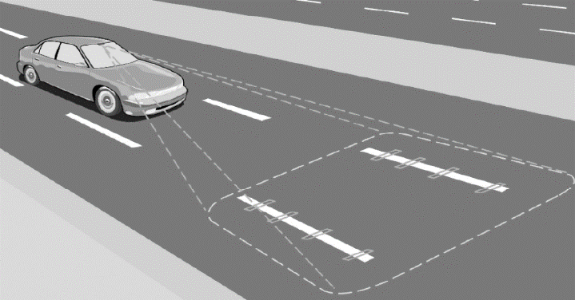
Vision-based Lateral Control – Running Example
input
Stereo Camera
frames/
30fps
Computing Platform (MPSoC)
Stereo Camera input (30 fps)
Image
Processing
Control Computation
Actuation
S
C
A
h
S
C
A
Long variable sensing
h > fps⁻¹
Can we optimise Quality-of-Control using multiprocessor technology?

Slide 3
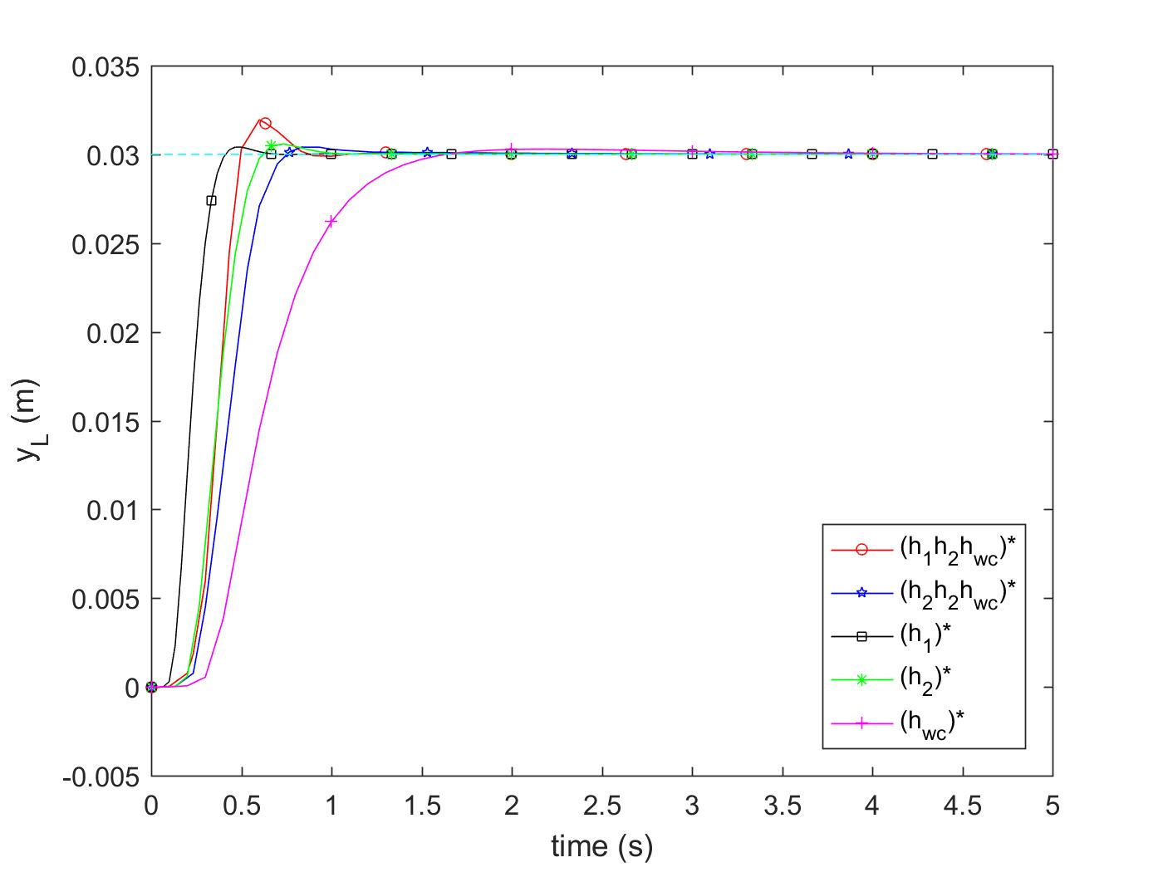
Vision-based Lateral Control – Results
Stereo Camera input (30 fps)
h
S
C
A
QoC = (settling time)⁻¹
Can we optimise Quality-of-Control using multiprocessor technology?
Yes.
Scenario- and Platform-Aware Design (SPADe) approach

Slide 4
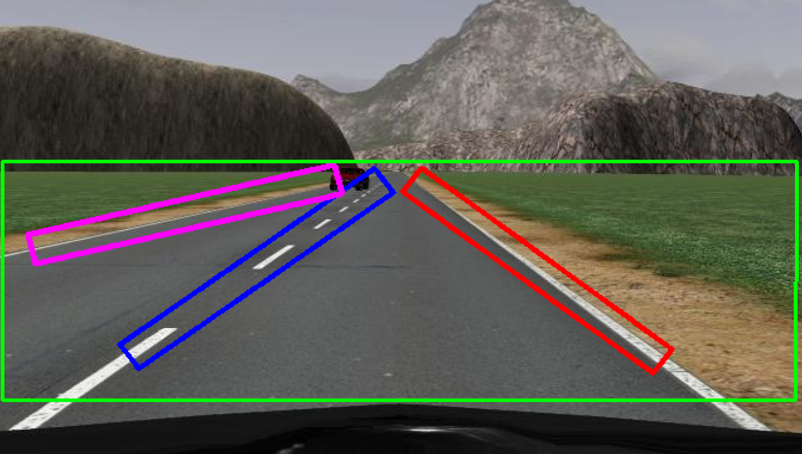
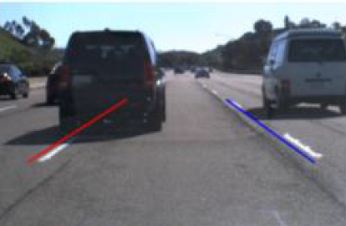
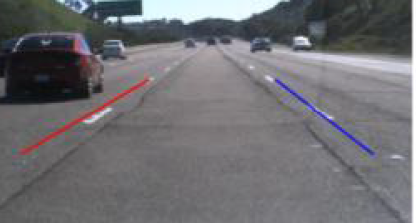
Motivation: workload variations
Regions-of-Interest (RoI)
input (30 fps)
0
100
200
time (ms)
S
C
A
S
C
A
S
C
A
Controllers designed for worst-case sampling period
Execution time of ‘S’ depends on workload variation
Idle resources for less workload (inefficient resource utilisation)

Slide 5
Related Work
Control domain
Robust design
Reconfigurable pipelining
Model predictive control
State estimators
…
Embedded domain
Model-based design
System-scenario based design
…
Does not model and explicitly consider
platform constraints
workload variations
Does not optimise for Quality-of-Control considering workload variations

Slide 6
Model-Based Design: sample as fast as possible
Modelling
Analysis
Design
Implementation
S
C
A
S
C
A
S
C
A

Slide 7
Model-Based Design: challenges
Modelling
Analysis
Design
Implementation
Parallelisation
Reconfiguration
Pipelining
Predictable
Platform-aware
Optimal
Stability
Arbitrary Switching vs QoC
Predictable
Cost of Implementation
Mutually Dependent
S
C
A
S
C
A
S
C
A

Slide 8
SPADe – Design Questions
For a given application and a platform allocation, design
Mapping configurations (bindings + schedules)
Controller configurations (sampling periods + sensor-to-actuator delays + controller gains)
Reconfiguration mechanism
such that we
Maximise effective resource utilisation and
Improve Quality-of-Control (QoC)
Inputs
Application
Workload variation
Platform Allocation
Camera input fps
Application Model
Platform Model
Modelling
Timing Analysis
Analysis and Design
Binding + Scheduling
Controller Design
Reconfiguration Mechanism
Implementation
Mapping Configurations
Controller Configurations
Resource utilisation
Quality-of-Control (QoC)

Slide 9
SPADe – Modelling
Model should consider
Workload variations
Parallelisation
Reconfiguration
with tool support for
Timing analysis
Mapping
Application
Workload variation
Platform Allocation
Camera input fps
Application Model
Platform Model
RoIP
e_{p}
y₁
y₁
RoID
e_{d} + c
RoIM
w*e_{m}
C
e_{c}+ d(Si)
A
e_{a}
Camera input
c
y₂
RoIP
e_{p}
y₂
z₂
z₂
P₀
RoIP
RoIP
RoIP
RoIM
C
A
1
P₁
d(S_{i})
Scenario-Aware Data Flow (SADF)
*Pipelining is not considered in this work

Slide 10
SPADe – Modelling
Model should consider
Workload variations – y₁, y₂
Parallelisation – RoIP
Reconfiguration – c
with tool support for – SDF3
Timing analysis
Mapping
Application
Workload variation
Platform Allocation
Camera input fps
Application Model
Platform Model
RoIP
e_{p}
y₁
y₁
RoID
e_{d} + c
RoIM
w*e_{m}
C
e_{c}+ d(Si)
A
e_{a}
Camera input
c
y₂
RoIP
e_{p}
y₂
z₂
z₂
P₀
RoIP
RoIP
RoIP
RoIM
C
A
1
P₁
d(S_{i})
Scenario-Aware Data Flow (SADF)
*Pipelining is not considered in this work

Slide 11
SPADe – Key Observations (1/2)
Due to our modelling and design choices
For a workload scenario sequence (S1)*, i.e. S1→S1→S1…
Relates data flow analysis with control design
A workload scenario sequence S2→S1→S1 implies a sampling period sequence h2→h1→h1
Enables compositional analysis
P₀
RoIP
RoIP
RoIP
P₁
RoIP
RoIP
RoIM
C
A
RoIP
RoIP
RoIM
C
A
RoIP
RoIP
RoIM
C
A

Slide 12
SPADe – Key Observations (2/2)
Multiple workload scenarios can have same sampling period
Due to platform constraints
Platform allocation
Camera input fps
A system scenario abstracts multiple workload scenarios
Restricts arbitrary switching
Optimises for QoC
For runtime implementation
S
C
A
P₀
RoIP
RoIP
RoIP
RoIP
P₁
RoIP
RoIP
RoIM
C
A
RoIP
RoIP
RoIM
C
A
RoIP
RoIP
RoIM
C
A
S
C
A

Slide 13
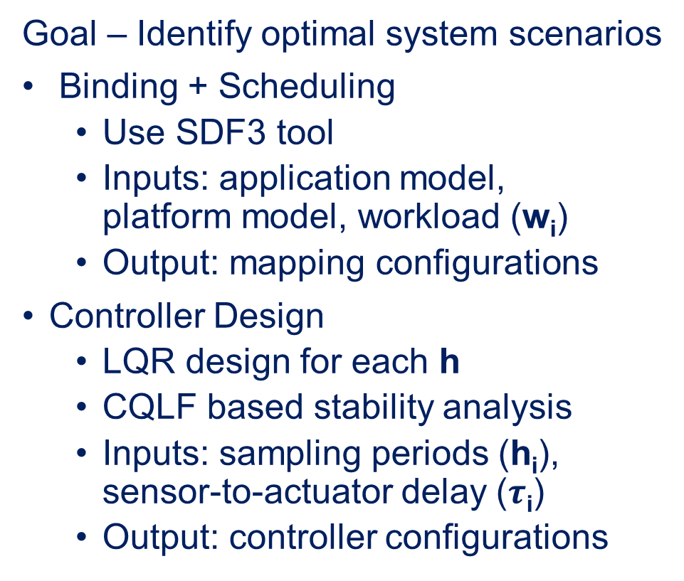
SPADe – Analysis and Design
Goal – Identify optimal system scenarios
Binding + Scheduling
Use SDF3 tool
Inputs: application model, platform model, workload (w_{i})
Output: mapping configurations
Controller Design
LQR design for each h
CQLF based stability analysis
Inputs: sampling periods (h_{i}), sensor-to-actuator delay ($τ$_{i})
Output: controller configurations
Application
Workload variation
Platform Allocation
Camera input fps
Application Model
Platform Model
Timing Analysis
Binding + Scheduling
Controller Design
Mapping Configurations
Controller Configurations

Slide 14

SPADe – Analysis and Design
Application Model
w_{i}
Platform Model
Application
Workload variation
Platform Allocation
Camera input fps
Application Model
Platform Model
Iteration due to mutual dependence
Binding + Scheduling
Timing Analysis
Timing Analysis
h_{i} & $τ$_{i}
Binding + Scheduling
Controller Design
Identify system scenarios
restrict h_{i}
Mapping Configurations
Controller Configurations
Controller Design

Slide 15
SPADe – Analysis and Design
Goal – Identify optimal system scenarios
Identify stable set of sampling periods or switching scenarios
Identify maximum workload that fit each sampling period or scenario
Iteration stops
Generate look-up table for reconfiguration mechanism
Application
Workload variation
Platform Allocation
Camera input fps
Application Model
Platform Model
Timing Analysis
Binding + Scheduling
Controller Design
Reconfiguration Mechanism
Mapping Configurations
Controller Configurations

Slide 16
SPADe – Implementation
Look-up table based reconfiguration mechanism
Assumption: Image header has information on workload
# Regions-of-Interest
Application
Workload variation
Platform Allocation
Camera input fps
Application Model
Platform Model
Timing Analysis
Binding + Scheduling
Controller Design
Reconfiguration Mechanism
Mapping Configurations
Controller Configurations

Slide 17
SPADe – Conclusion
A scenario- and platform-aware design approach
Better than worst-case based design
Improves QoC and maximises effective resource utilisation
Future work
Multiple applications sharing a platform allocation
Optimal control strategy for this setting
Application
Workload variation
Platform Allocation
Camera input fps
Application Model
Platform Model
Timing Analysis
Binding + Scheduling
Controller Design
Reconfiguration Mechanism
Mapping Configurations
Controller Configurations

Slide 18




+31 626 827 900
S.Mohamed@tue.nl
linkedin.com/in/sajidmohamed

